Slide 1
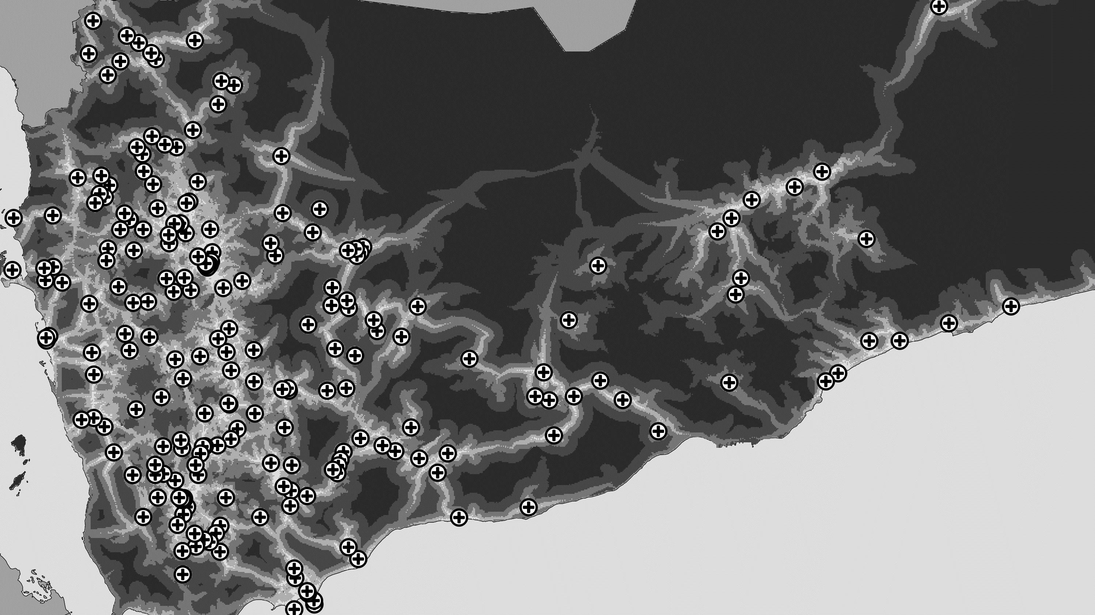
GOSTnets | Tutorial – February 25th and 26th 2020
Notes:
Good evening everyone! I’m Charles, and I have been working a lot with the Geospatial Operations Support Team, or GOST, to develop something I am calling “GOSTnets.”
But first off, congratulations to you, the audience! For potentially making it through up to 14 lightning talks today. Truly electrifying!

Slide 2
Course outline
 | Monday 25th | Tuesday 26th
9 - 9:45 | Intro to GOSTnets | Cleaning Bad Data
9:45 – 10:45 | Setting up Data | Gravity Models
Coffee Break
11 – 12 | Running an OD | Network Disruptions
AFTERNOON | 1 on 1 Discussions

Slide 3

Intro to GOSTnets
Who is everyone
What is GOSTnets
Why GOSTnets

Slide 4




Objective: Estimate improve access measurements
Notes:
It was with this context that I was asked to estimate access to healthcare in Yemen.
How are you supposed to approach a problem like that, when no one has been able to go there for 3 years? Where do you get your data from?
Traditional tools like household surveys are out of the question.
The way forward lay in a combination of open data, remote sensing, and a whole lot of elbow-grease

Slide 5




People
Facilities
Roads
GOSTnets
insight
Notes:
With our three blocks as up to date as possible, we were ready to calculate some estimates of accessibility, with the addition of one more ingredient.
I want to introduce you to the ‘special sauce’, developed by GOST, that takes these three data building blocks and makes them incredibly powerful.
For now, I am calling it GOSTnets.

Slide 6

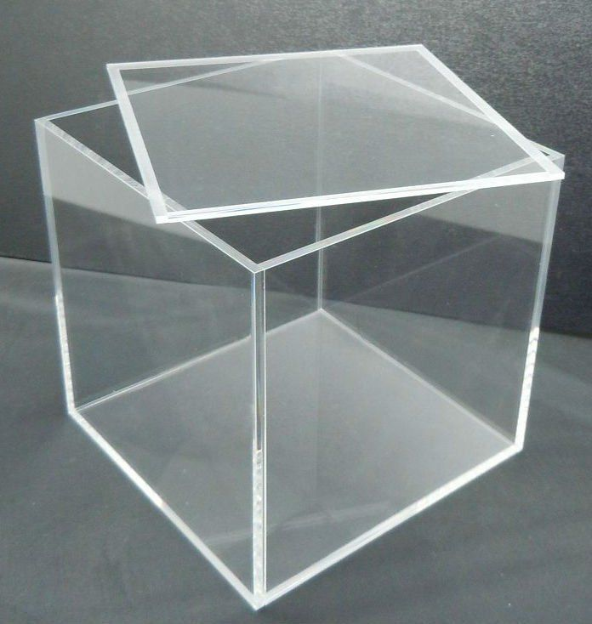
Other options
(Google Maps, Apple Maps, OSRM...)
GOSTnets
Origin(s), Destination(s)
Origin(s), Destination(s)
Travel times
(single-journey | small matrices)
Travel times
(any-size matrices)
Notes:
GOSTnets is a python library designed to make calculating travel times easier that it has ever been before.
A lot of tools exist like this already: Google Maps, Apple Maps, OSRM, Mapbox... There are many of them, and they work well. However, it’s really hard to customize what they are doing.
What if you want to add in a Bridge that doesn’t exist yet to a road network, like the Padma bridge in Bangladesh?
What if you want to calculate travel times for a network where some roads have been flooded, like we did for Dar es Salaam?
What if you want to build in border crossing times to your travel time estimates, as we needed to do for the Western Balkans?
Well, off-the-shelf tools won’t help much with that.
But with GOSTnets, the entire process of building a network and modelling movement on it is transparent. We can see inside the proverbial ‘black box’, because we choose what we put in that box, and have defined how each element interacts.

Slide 7
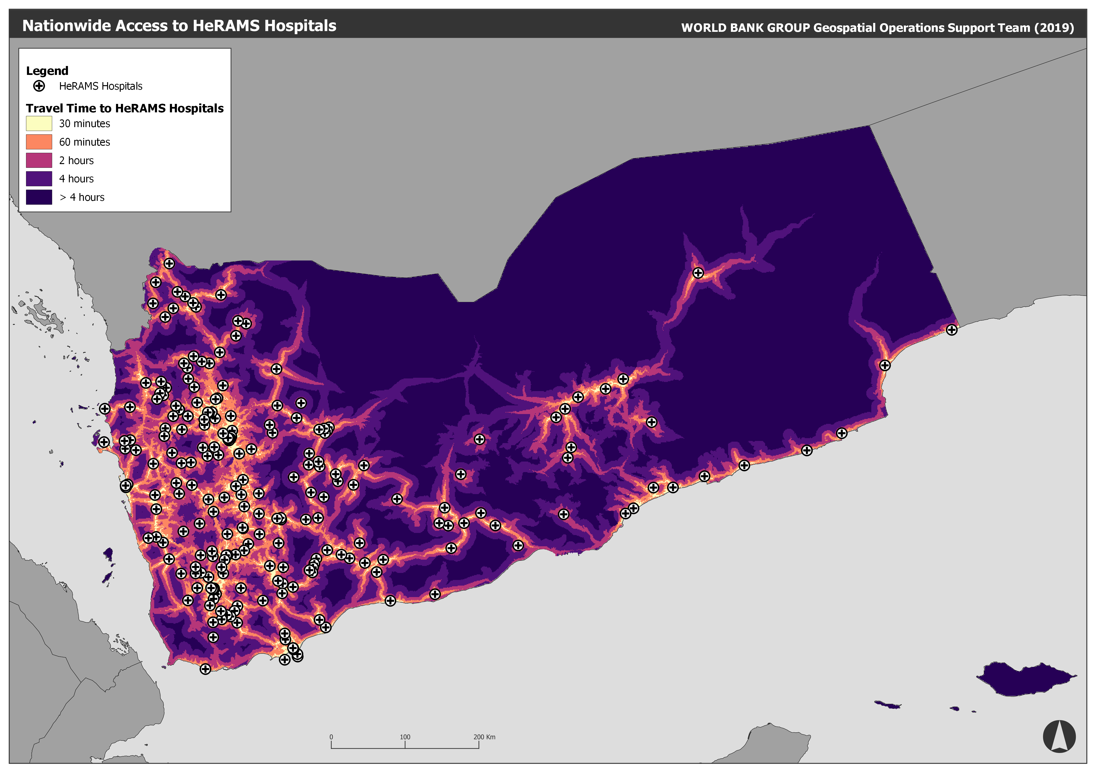
44%
of Yemeni live within 30 minutes travel of their nearest hospital
That figure
rises to
68%
for access
within 1 hour
Notes:
Once we put the hospitals data from Kent, and the cleaned up road network from Manal in the GOSTnets box, it generated these travel time thresholds, or isochrones, for Yemen.
When we intersect these with Andy’s population data, we find that only 44% of Yemen’s population lives within 30 minutes’ drive of a functioning hospital, and 68% within 1 hour.

Slide 8
Design Notes
Start from first principles – e.g. we prefer to unpack .osm.pbf than to import a graph with OSMNX
Explicit is better than Implicit – a lot of functions include print statements to explain what’s going on; function names are as descriptive as possible
Step by Step is best – this is a Library of helpful functions, that often need to be run one after another. There should be no ‘mystery factor’:
Step 1: imagine a graph
Step 2: launch anaconda
Step 3: ????
Step 4: profit
Built on Networkx’s graph architecture along with Geopandas

Slide 9


Slide 10
But what is a graph?!?!?!!?
A graph is composed of nodes (points) and edges (lines that connect points).
A road network can be visualized as a collection of nodes (junctions) and edges (roads between junctions)
Nodes and edges have associated properties, stored in a data dictionary
u
(u, v, data)
where
data = {
‘geometry’:….,
‘length’:…,
‘infra_type’,…,
‘speed’:…}
(u, data)
where
data = {
‘junction_type’:….,
‘property_2’:…}
v

Slide 11
INSTALL GOSTnets
Github.org/worldbank/GOSTnets

Slide 12
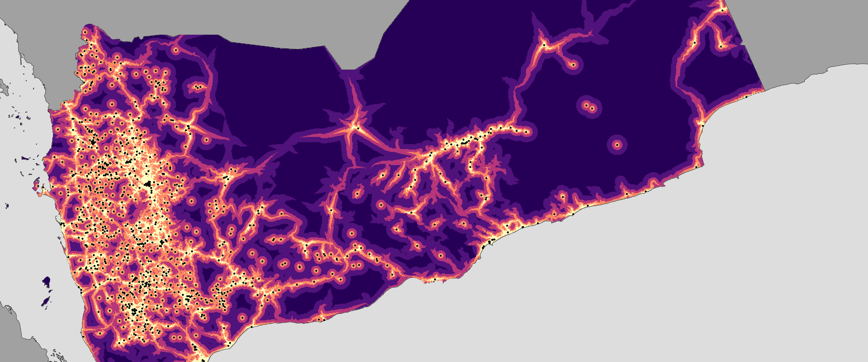
Simple Network Analysis with GOSTnets and OSM

Slide 13
Now I have my OSM as a graph…can I please get on with it?
No.
OSM data comes in in a topologically very messy format – unconnected roads, multiple interstitial nodes (nodes with degree = 2)
Q: Can GOSTnets help me?
A: sort of. I have come up with a cleaning process to remove interstitial nodes and topologically simplify complex node structures
You can also use networkx to drop small disconnected subgraphs if you so wish
!gotcha: if you call networkx.strongly_connected_components(), you will get the largest connected sub-graph…but if your country includes islands, you might lose the roads on those, which are perfectly valid!

Slide 14
Example 2: Topologically simplifying a network
Example notebook: Clean Network.ipynb
https://github.com/worldbank/GOST_PublicGoods/tree/master/GOSTNets/Notebooks

Slide 15
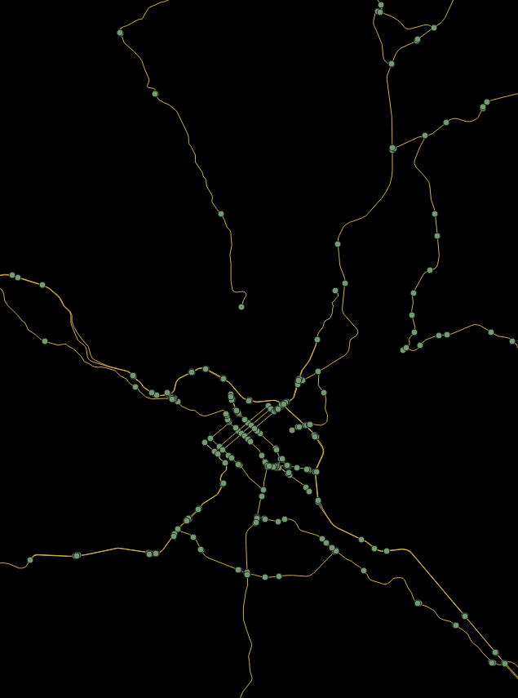
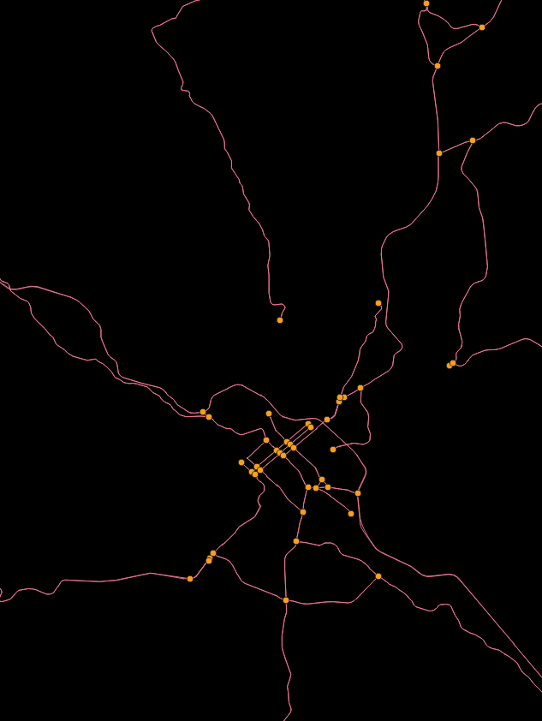
Pre simplification
Post simplification

Slide 16
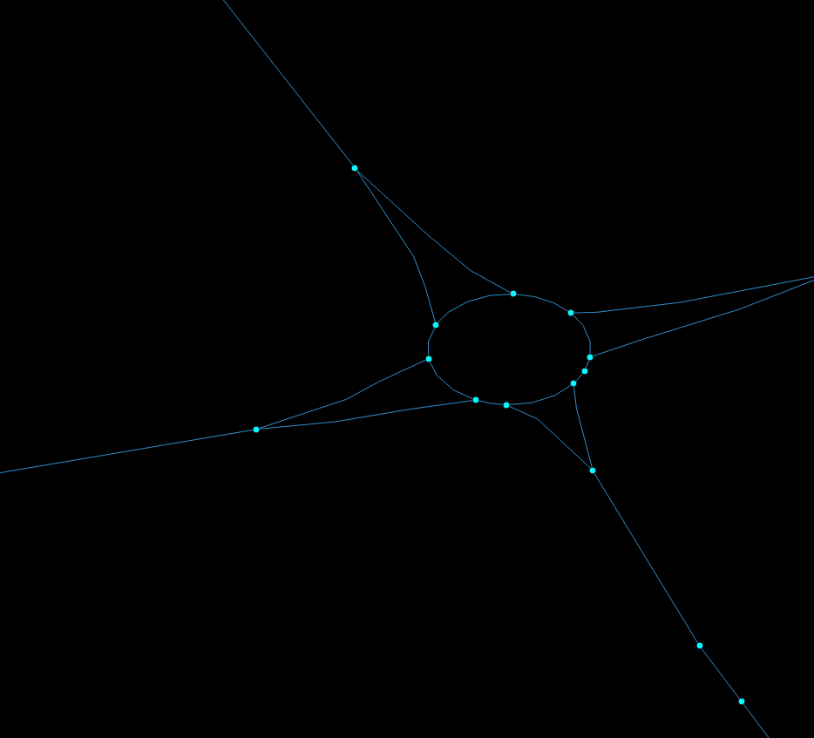
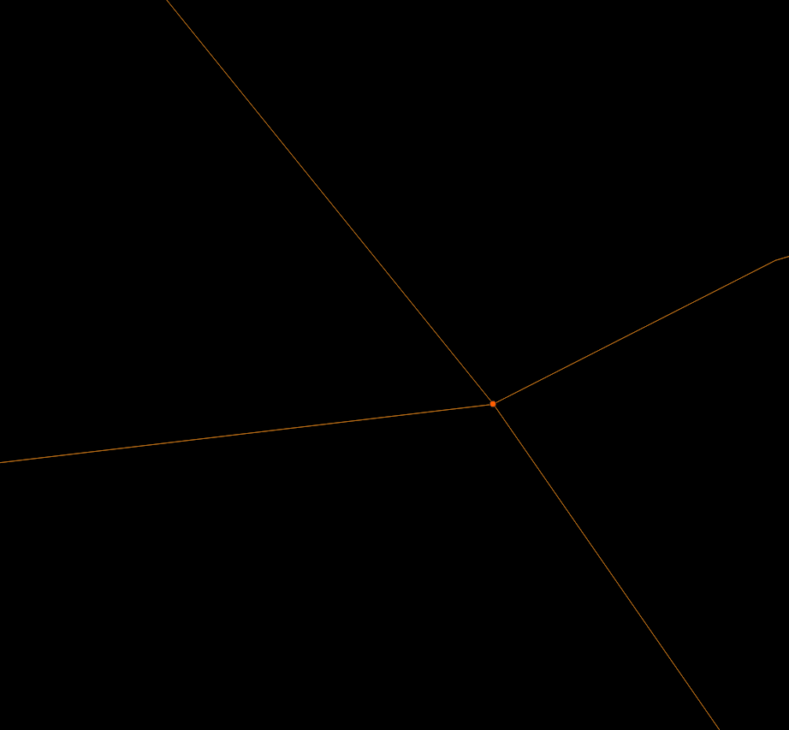
Pre simplification
Post simplification

Slide 17
Multimodal networks
Process:
Import and clean a road network as a graph object, G1
Import a GTFS feed as a networkx object (see: Peartree), G2
Ensure both networks have a common edge property for weighting calculations – e.g. ‘time’ – measured in a common unit (seconds)
Combine the two graphs using G3 = gn.join_networks(G1, G2)
Calculate O-D matrix across G3 using gn.calculate_OD(G, origins, destinations, weight = ‘time’)
Worked example: Multimodal Example.ipynb

Slide 18
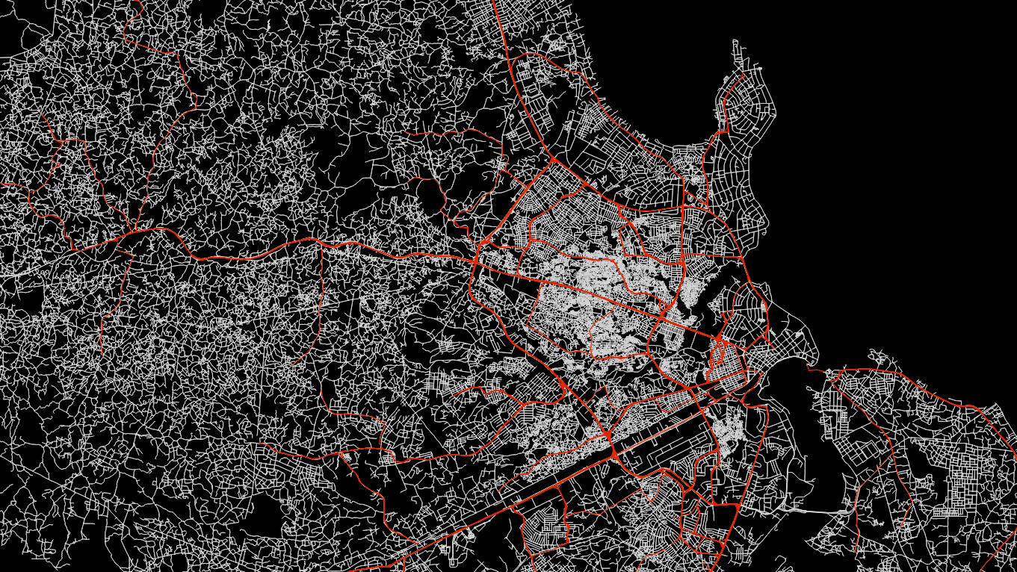
Dar Es Salaam
Grey = walking network
Red = GTFS feed

Slide 19
Disruption / Flood / Criticality analysis
Assign node values from a raster layer that intersects the graph: gn.sample_raster(G, tif_path, property_name)
G – graph object
tif_path – file path to your raster object (n.b. check CRS…)
Property_name – the function will add the raster value as an attribute to a node. Name this attribute!
Disrupt your networks with gn.disrupt_network(G, property, thresh, fail_value):
G – the graph object
property – the node’s attribute value you are disrupting
thresh – the value beyond which the node will be removed from the graph – and any connecting edges
fail_value – the replacement weight in the graph for disrupted edges
Example notebook: Flooding Example.ipynb

Slide 20
Graphtool
GOSTnets’ gn.calculate_OD() does all of its computation in networkx.
This is not very efficient.
For massive matrices (50,000 elements+), it is suggested to use graphtool
Graphtool is written in C++, and is delivered inside a docker environment
GOSTnet’s sub-library – GOSTnet_graphtool_utils.py – makes exchanging between networkx and graphtool formats easy (nx2gt()).
Further, pre-developed scripts leverage multiprocessing to achieve enormous magnitudes of speed-up (100x or more).
Let’s talk if you think you are in this position

